Slide 1
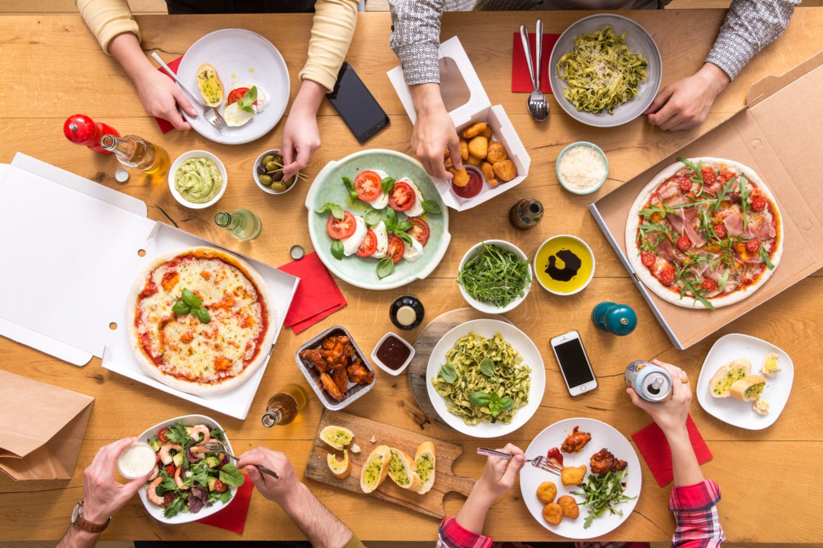






ONLINE PRE ORDERING SYSTEM
FOR RESTAURANTS
INTRODUCING TO SIMME PLATFORM

Slide 2
PROBLEM IDENTIFICATION
OFFLINE OPERATING RESTAURANTS
Orders take a long time prepare and serve
Restaurant administration issues / papers missing
Customer order is taken manually
Manual Management / Paper Based

Slide 3
CASE ANALYSIS
OPERATING RESTAURANTS
Waiters
Digitalization
No human involvement
Order tools
Menu/time/restaurant
Track orders
...
WHAT?

Slide 4
CASE ANALYSIS
OPERATING RESTAURANTS
Today`s world
Increase profit
Customer satisfaction
User friendly
Increase of online usage
WHY?

Slide 5
CASE ANALYSIS
OPERATING RESTAURANTS
Restaurants
Chains
Franchises
Shopping malls
Worldwide
...
WHERE?

Slide 6
CASE ANALYSIS
OPERATING RESTAURANTS
Convenience
Simme app
Commission
Ads
...
HOW?

Slide 7
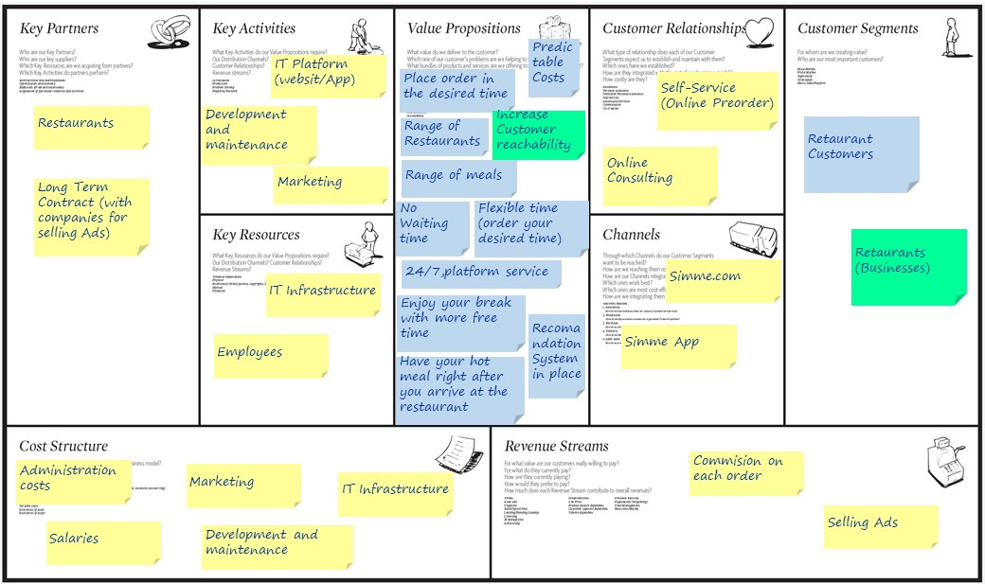
BUSINESS MODEL
SIMME PLATFORM

Slide 8
SOLUTION
SIMME PLATFORM

Slide 9
BENEFITS
SIMME PLATFORM

Slide 10
We appreciate your attention!
Thank You!
Questions? Feedbacks? Remarks?

